Slide 1
The Microsoft Bot Framework
[ Instructor Name ]
[ Instructor E-mail ]

Slide 2
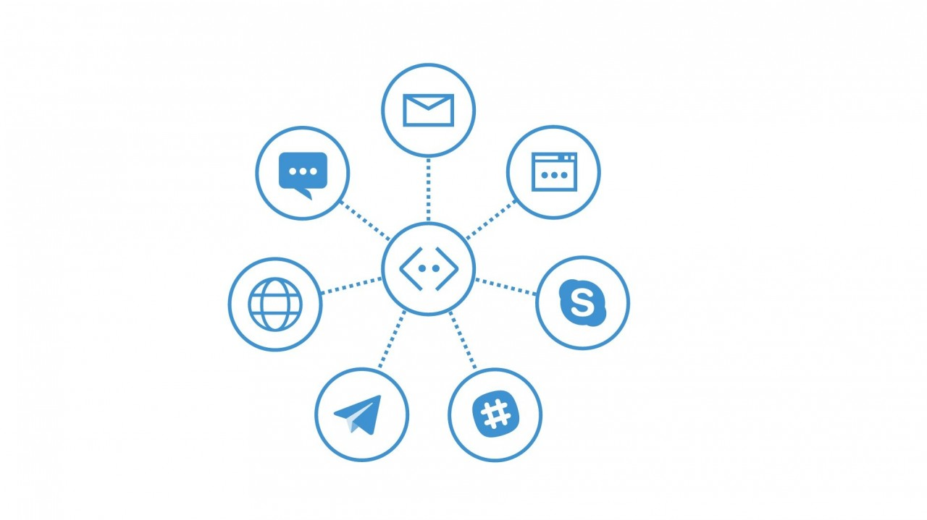

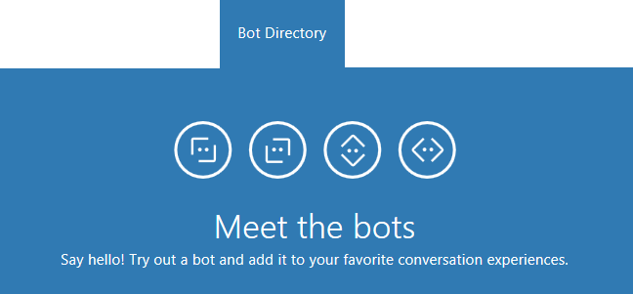
Microsoft Bot Framework
The Microsoft Bot Framework is a comprehensive framework of tools and services developers can leverage to build and deploy high quality, conversational bots in any experience and language.
Notes:
Regardless of the language or platform, developers building bots face the same common challenges: Bots require basic input and output, they need language and dialog skills, they need to be responsive and scalable; and they must connect to users in any conversation experience and language the user chooses. The Microsoft Bot Framework provides the foundation for what developers need to build, connect, manage and publish intelligent bots that interact naturally with users over a variety of services from text/SMS to Skype, Slack, Facebook Messenger, Kik, Office 365 mail and other popular services.

Slide 3
Language & Platform Support
Windows
Mac/Linux
Robust Bot Framework Emulator via .NET
.NET, Node.js, and REST API
Visual Studio Code and higher
Forms via FormFlow
Bot State Service
Integratedn Visual Studio templates
Integrated publishing
Simple Bot Framework Emulator via Mono
Node.js and REST API
Visual Studio Code only
Console emulator debugging
Command-line publishing
Notes:
Although the development and deployment of bots can be achieved on any platform the Microsoft Bot Framework provides differing mechanisms and tools depending on the platform and language of choice. The primary toolset for bot development is Visual Studio, in any edition, including Visual Studio Code.

Slide 4
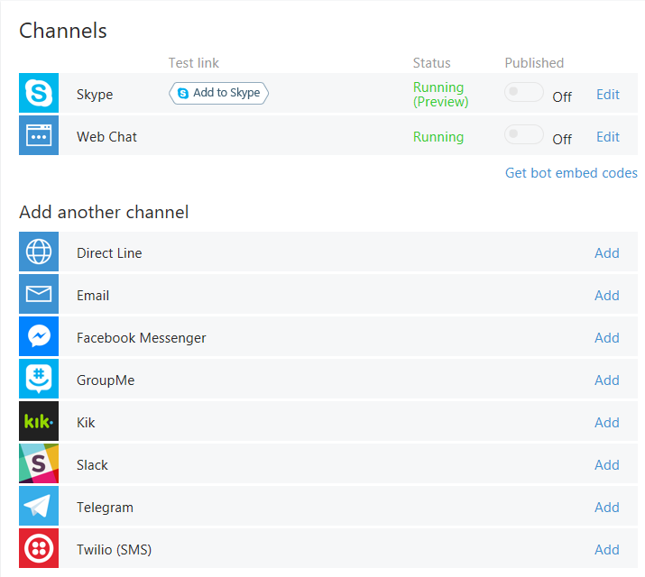
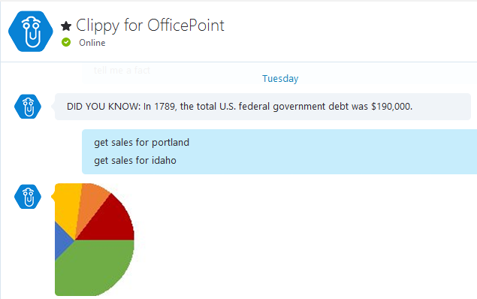
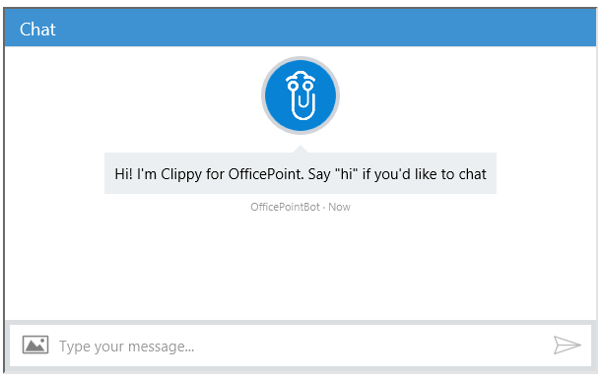
Supported Channels
Channels are currently available for Skype, web, email, Facebook, GroupMe, Kik, Slack, Telegram, Twilio, and direct line app integration.
Notes:
Channels are essentially third party services that a bot can communicate and interaction with in a standardized way. The Microsoft Bot Framework provides developers with a developer portal and SDK to build bots, a Bot Connector service to connect to social channels such as Twitter and Slack, and a Bot Directory to discover and use existing bots.

Slide 5
The Connector
The Connector (or Connector Service) handles all communication, conversations, state, and authorization activities between a bot and users.
var connector = new ConnectorClient(incomingMessage.ServiceUrl);
var replyMessage = incomingMessage.CreateReply(“How can I help?”);
await connector.Conversations.ReplyToActivityAsync(replyMessage);
Notes:
The Microsoft Bot Connector is a communication service that helps you connect your bot with many different communication channels (Skype, SMS, email, and others). If you write a conversational bot or agent and expose a Microsoft Bot Framework-compatible API on the Internet, the Bot Framework Connector service will forward messages from your bot to a user, and will send user messages back to your bot. The Connector is the primary mechanism used to communicate all information between a user and a bot, and includes methods to assist with authentication and state management.

Slide 6

Connector Service Flow
CHANNEL
Skype
Web Chat
Email
Facebook
GroupMe
Kik
Slack
Telegram
Twilio
Direct Line
CONNECTOR
Routes messages, manages state, bot registration, tracking, services (such as translation) and per-user and per-bot storage
Your Bot’s Web Service
Notes:
Although all communication between a bot and a channel happens via the Connector., this is not a “technical” requirement, per se, but is instead the entire crux of communicating with diverse channel contracts universally. The Connector handles all the complexity of state management, bot registration, and storage in a way that can extend and apply across all third party services. Communication starts with a user interacting with your bot, then communicating via your bot service, then to the connector, and finally to the third party channel. Responses from the channel always occur in reverse of the user interaction flow.

Slide 7
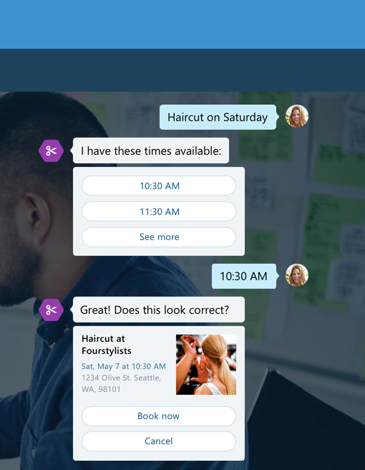
Activities
An Activity is a specific event that occurs between a bot and users, such as an actual message, or conversation notification.
Notes:
An Activity is the object or information used to communicate between a user and a bot. When an Activity is sent, there are a number of properties and methods you can use and populate to control your message and how it gets presented to a user. There are various types of Activities that can be used as well, including Activities to communicate system operations or channel system operations to the bot, enhancing the information about the bot and/or the state of the channel. Every Activity being routed through the Connector has a Type field, which is typically “Message”, however there are system notifications as well, such as “Typing”, “Ping”, or “User Data Deleted” (for when a user leaves a conversation.)

Slide 8
Types of Activities
Activity Type | Description
Message | Sent when general content is passed to or from a user and a bot
Conversation Update | Sent when the conversation's properties change, for example the topic name, or when user joins or leaves the group
Contact Relation Update | Sent when bot added or removed to contact list
Delete User Data | Send when user is removed from a conversation
Typing | Sent when a user is typing
Ping | Send when a keep-alive is needed

Slide 9
Messages
A Message is an overt communication between a bot and users, such as a user asking a question, or a bot responding with a reply.
Message Property | Description
Text | A text payload in markdown syntax which will be rendered as appropriate on each channel.
TextFormat | Plain, markdown, xml (Skype only)
Locale | Two-digit culture/region locale
Notes:
The message activity is the core object exchanged between the user and the bot. It can represent a wide range of values from simple text input and response all the way to complex multiple card carousel with buttons and actions
For many developers the Text property is the only property you need to worry about. A person sent you some text, or your bot is sending some text back. There are 2 core properties for this, the Text and Locale property.

Slide 10
Intents & Prompts
The mechanisms leveraged by the Microsoft Bot Framework to determine what a user really wants to do are typically referred to as intents and prompts.
?
Notes:
The Microsoft Bot Framework ships with a number of built-in prompts, such as number, text, and confirm, to help a bot determined what a user really intends, or to refine choice during the course of a conversation. These built-in prompts are implemented as a Dialog so they’ll return the users response, typically in a “waterfall” fashion. The built-in prompts also let the user cancel an action by saying something like ‘cancel’ or ‘never mind’ or even “start over”.

Slide 11
Managing State
Not all bots require state management outside of what the Connector provides inherently, however if you need to manage state, there are various methods.
Custom storage methods, such as a remote database
Class-specific logic at runtime
Implicitly during a Dialog or Form process
The Bot Framework State Client
Notes:
Not all bots require state management outside of what the Connector provides inherently, however if you need to manage state, there are various methods. For light-weight, persistent state across sessions, the Bot Framework State Client is ideal, as it retains information based on specific user data and conversational history.

Slide 12
Using Dialogs
Dialogs are a way of wrapping an entire “experience” into an easily managed interaction based on a “chained” and “conversational” paradigm.
Send information to a User
Prompt a User for more information or confirmation
Provide conditional logic
Provide “as you need it” content
Dialogs can contain or forward to other Dialogs.
Notes:
Dialogs can help developers create simple bot experiences where a conversation and it’s elements are generally “known”. Dialogs typically leverage the concepts of “intents and prompts” to fine tune what a user really needs. Dialogs can also be nested or chained depending on the results of a prompt or dete4rmined intent, making them ideal for fundamental conversations.

Slide 13
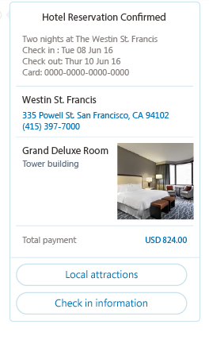
Attachments, Cards and Actions
Bot conversations can contain enhanced content in the form of Attachments, Cards, and Actions.
Media attachments: Image, audio, video, file
Rich card attachments: Hero, thumbnail, receipt, sign-in
Button and card actions: Open url, call , play audio/video, show image, download file, sign in
Notes:
Although not universally supported by all channels, most third-party channels provide some ability to attach “rich” objects, meaning content other than text, like audio and video, as well as the ability to have “enhanced” interactions such as viewing images and downloading files. The Microsoft Bot Framework Connector performs all the heavy lifting of connecting attachment data structure to media attachments and rich cards on each channel, and provides failover scenarios where unsupported.

Slide 14
Integrating Language Understanding
LUIS is part of Microsoft’s Cognitive Services offering and can be used for any device, on any platform, and any application scenario.
Essentially what Cortana uses on the backend for language and sematic interpretations
Provides “built in” logic that can be leveraged “out of the box”
Natural, adaptable, conversational intelligence
Model-based via intents and entities
Notes:
Although LUIS services can be designed and leveraged in any app development scenario, they are ideal for bot integration due to their intelligent, conversational, and adaptable behavior. LUIS integration is typically managed via “Intent” Dialogs that create a seamless connection between bot logic and semantic interpretations and entities. For large-scale, robust bot development, LUIS is almost a requirement, as the prediction and implementation of complex language analysis will typically be beyond the scope of any application.

Slide 15
Hands-On Lab
Microsoft Bot Framework HOL.html

